Slide 1
Big Data Hadoop and Spark Real Time
Project – Telecommunication using K-Means Algorithm
Ishan Gandhi
ishan2303@gmail.com
24th Feb, 2017

Slide 2
Maximize network coverage using K-Means Clustering
LoudAcre Mobile is a mobile phone service provider which has introduced a new Open Network campaign.
The company has invited users to raise a request to initiate a complaint about the towers in their locality, if they face issues with their mobile network.
LoudAcre has collected the dataset of users who had raised the complaint.
The fourth and the fifth field of dataset has latitude and longitude of users which is an important information for the company.
Create three clusters of users with k-means algorithm. This will help Loudacre maximize the coverage for its users.

Slide 3
Project Goal Requirements
Load dataset in spark and create a data frame.
Using K-Means Algorithm, create three clusters of users.
Find out the cluster centres using latitude and longitude data.
This will help the company to built mobile towers on the specific cluster-centre coordinates and maximize network coverage.

Slide 4
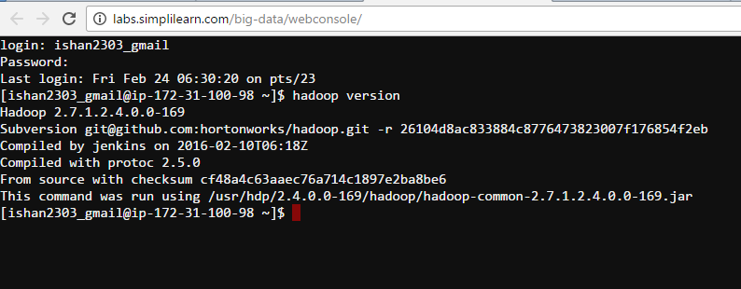
Hadoop Architecture
Hadoop 2.7

Slide 5
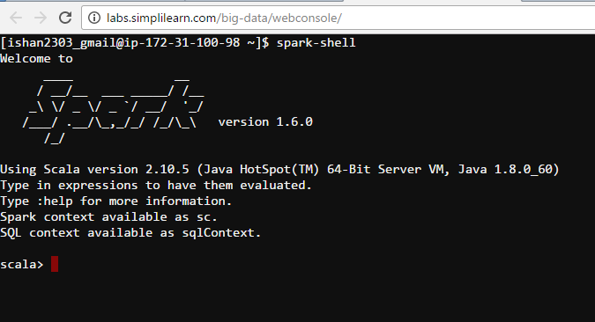
Apache Spark
Scala

Slide 6
Techniques used
From Lesson 03 to load dataset into HDFS.
From Lesson 11 on Spark
From Lesson 16 to work with Spark SQL
From Lesson 15 on Spark Algorithm.
Project on realized on Hadoop cloudlab architechture.
Bigdata and Hadoop Developer Batch
6_jan_16-17-18-19-20-23-24-25-26-30-31_feb-1_2017

Slide 7
Data Processing

Slide 8
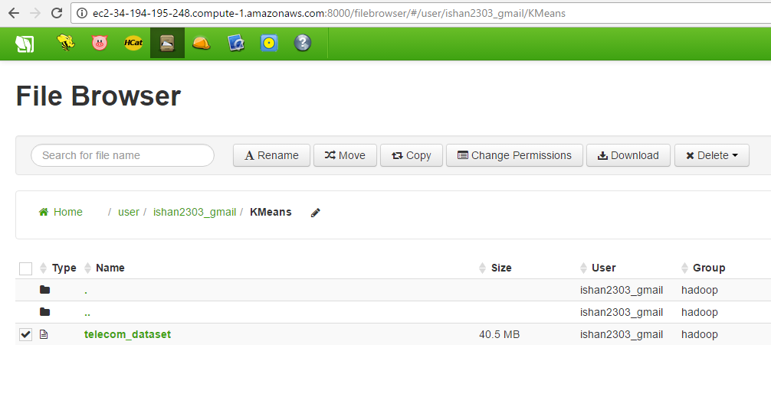
Upload dataset to HDFS
Dataset uploaded using Hue file browser.

Slide 9
Data Processing in Spark
1. Load data in spark.
val input = sc.textFile("KMeans/telecom_dataset")
create case class.
case class telecom_case(date_time:String, place:String, extra:String, latitude:Double, longitude:Double)
Split data based on ",“
val telecom_split = input.map(x => x.split(","))
4. Convert RDD[Array[String]] to RDD[telecom]
val telecomrdd = telecom_split.map(e => telecom_case(e(0), e(1), e(2), e(3).toDouble, e(4).toDouble))

Slide 10
5. Create Dataframe.
val telecomDF = telecomrdd.toDF()
6. Print schema.
telecomDF.printSchema()
7. Register DF as Table.
telecomDF.registerTempTable("telecom123")
8. Sample query on table .
val result = sqlContext.sql("select * from telecom123 where place = 'Titanic'")
result.show()

Slide 11
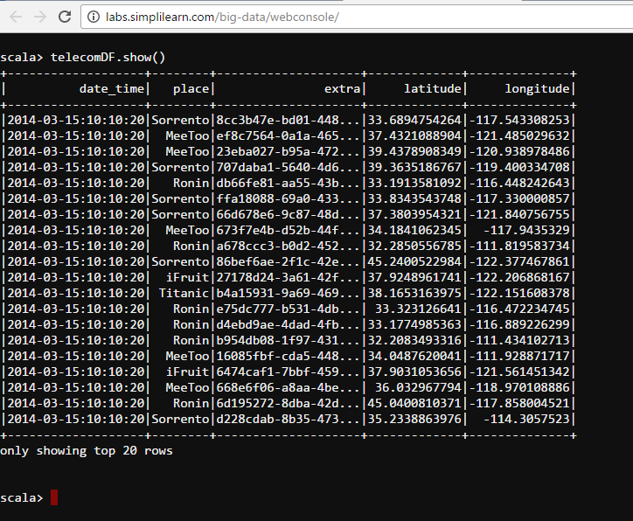
Dataframe created

Slide 12
Working with K-Means Clustering In Spark

Slide 13
1. Import required libraries.
import org.apache.spark.mllib.linalg.Vectors
import org.apache.spark.mllib.clustering.KMeans
import org.apache.spark.sql.functions._
2. Parse data (convert string RDD to vector RDD).
val vectors = telecomDF.rdd.map(r => Vectors.dense( r.getDouble(3), r.getDouble(4)))
Specify No of Iterations and Clusters.
val numClusters = 3
val numIterations = 20

Slide 14
4. Train the Model.
val kmeansModel = KMeans.train(vectors, numClusters, numIterations)
5. Check Cluster Centers.
kmeansModel.clusterCenters.foreach(println)

Slide 15
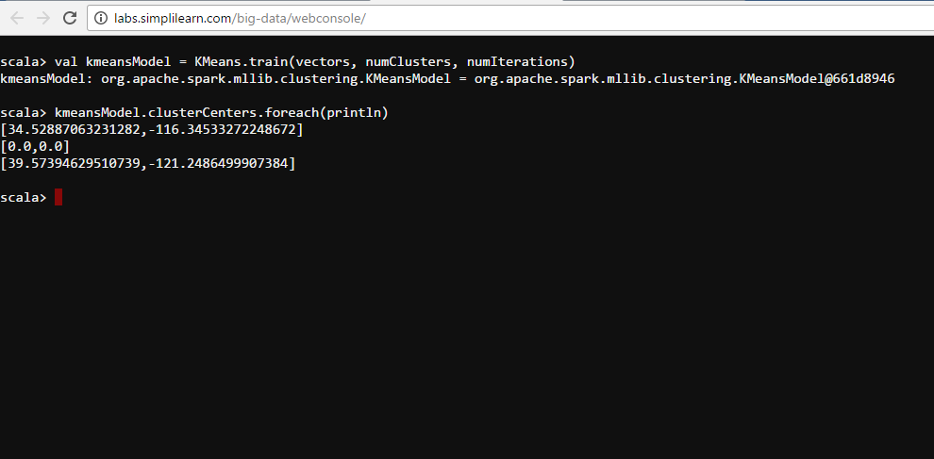
Output: Clustering Centers

Slide 16
Conclusion
After applying K-Means algorithm to the dataset, following 3 cluster centres are generated: (latitude, longitude)
1. (34.528, -116.345)
2. (0.0, 0.0)
3. (39.573, -121.248)

Slide 17
THANK YOU

